Slide 1
Your Ransomware Worked! Now What?
Money Laundering 101

Slide 2
Agenda
Who I am
Who I am not
Why you shouldn’t do this
The elephant in the room
The simplest possible method
Why it’s FAIL
Goals of laundering money
The basics
Another layer of fuckery
Questions

Slide 3
Who I Am
An idiot n00b competent people inexplicably tolerate

Slide 4
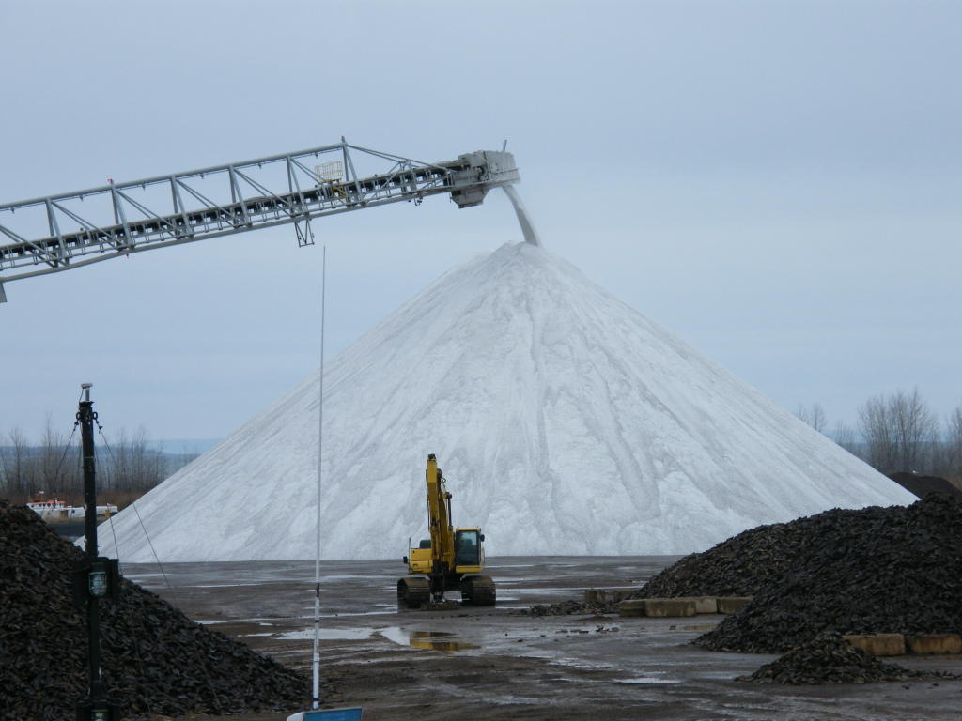
Who I Am Not
I am not a lawyer
I am not an accountant
I am not a financial advisor
I do not play any of those things on TV
I did not even stay at a Holiday Inn Express last night
Notes:
Obviously, I have never so much as contemplated doing any of the things I’m about to talk about. This is the appropriate amount of salt to take.

Slide 5

Why You Shouldn’t Do This
Each transaction in a scheme is a count of money laundering
https://www.justice.gov/usam/criminal-resource-manual-2101-money-laundering-overview
Each count can land you:
Up to 20 years in prison
The greater of up to $500,000 or double the amount involved
https://www.law.cornell.edu/uscode/text/18/1956
Notes:
You thought CFAA was fucked?
Money laundering laws are designed to put pressure on the money launderers to roll on the people they’re laundering money for. In some cases that means they’re competing with the threat of having your whole family murdered in front of you before being tortured to death.

Slide 6



Why You Shouldn’t Do This
Notes:
You all know the FBI. For some reason the Secret Service investigates “cybercrime” too. Anyone recognize that last one? Yeah, that’s the IRS; we’ll get back to them in a bit.

Slide 7
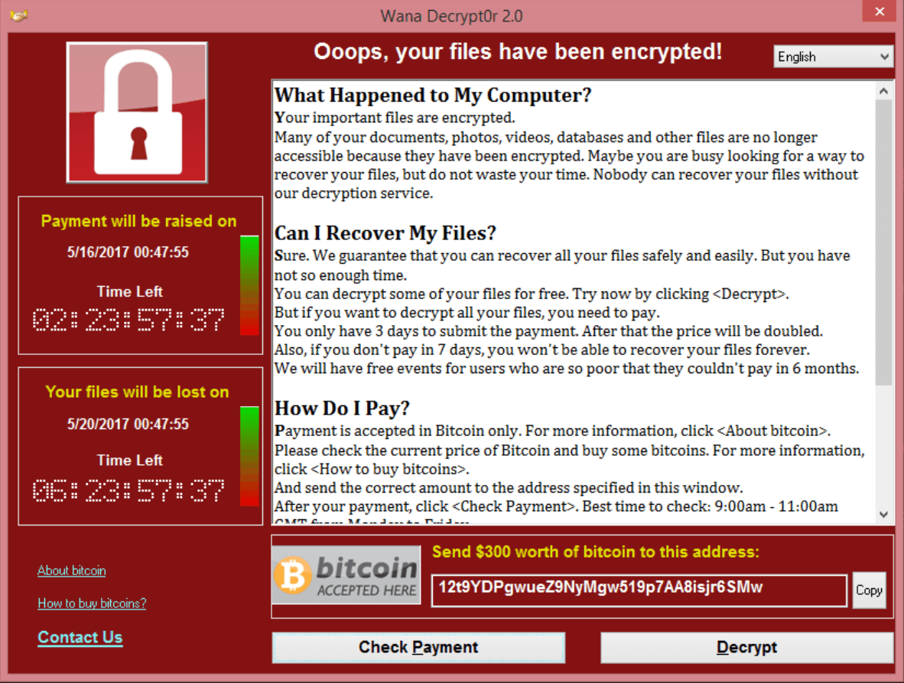
The Elephant In The Room
Notes:
Either this wasn’t meant to make money, or these guys are fucking idiots. They’re unimaginative, shit coders; as a result the original campaign’s only made about 50.5 bitcoin (whatever that’s worth this minute).

Slide 8
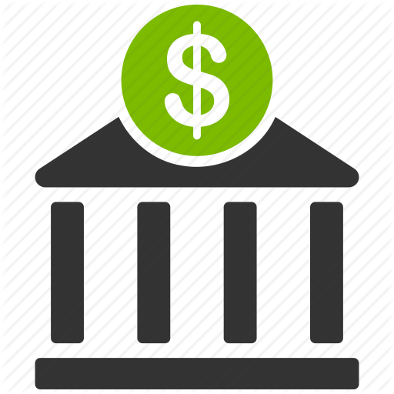
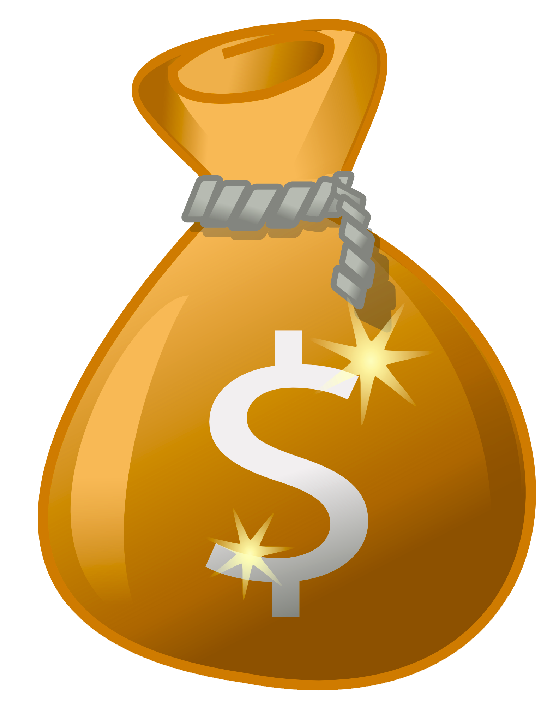



The Simplest Possible Cash Out

Slide 9
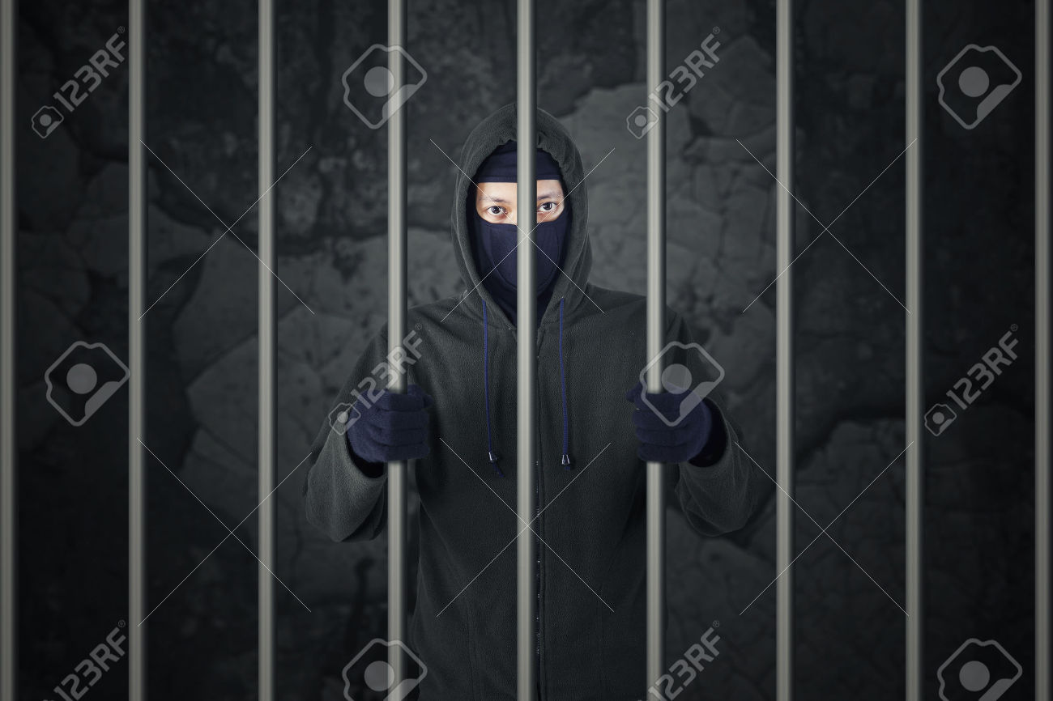
The Simplest Possible Cash Out
FAIL

Slide 10
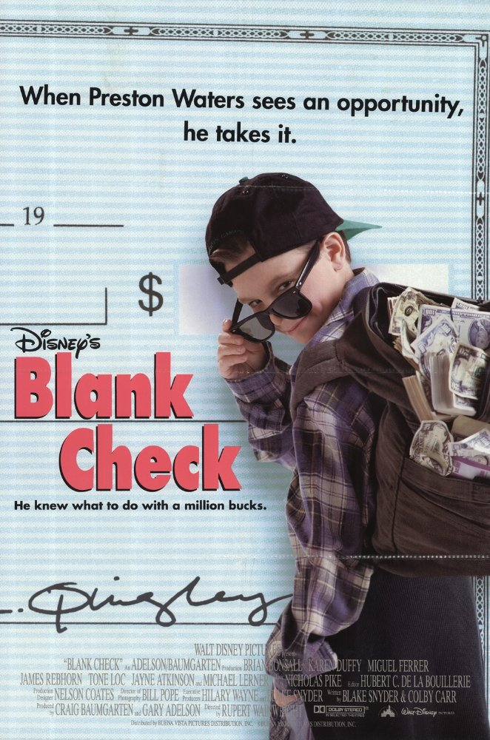
Why It’s FAIL
Easily tracked
No deniability
Doesn’t explain source of funds
Notes:
Bitcoin is like cash. If cash was marked bills recorded to a public ledger at every transaction. You can’t say you didn’t know about it since there’s no other reason you would be receiving at that address. And it doesn’t explain where the money came from; this one gets overlooked a lot, and it’s really, really important. We’ll talk about that a bit more later. Suffice to say, ‘90s kid movie shit don’t fly.

Slide 11
Goals For Laundering Money
Notes:
Before we get to what our goals actually *are*, let’s clear up a misconception. [click]

Slide 12
Goals For Laundering Money
“This method makes your money untraceable”
“Our magic box makes your network unhackable”
Notes:
These statements are pretty much identical; in that they’re both complete bullshit. Just like how sufficiently skilled, motivated, and funded hackers can get through any defense; sufficiently skilled, motivated, and funded forensic accountants can unravel any money laundering scheme.

Slide 13
Goals For Laundering Money
Notes:
So, what are our goals? [click]

Slide 14
Goals For Laundering Money
Make tracking the money a colossal pain in the ass
Notes:
While we can’t make it impossible to track the money, we can make it a time consuming, expensive, colossal pain in the ass.

Slide 15
Goals For Laundering Money
Make tracking the money a colossal pain in the ass
Provide early warning / exit route
Notes:
A good laundry scheme will also act as it’s own canary alerting you to an investigation giving you the ability to either break the chain and walk away or scarper off to someplace with nice beaches, strong drinks, and beneficial extradition policies.

Slide 16
Goals For Laundering Money
Make tracking the money a colossal pain in the ass
Provide early warning / exit route
Provide a plausible source of legitimate income
You *want* to pay taxes
Notes:
Remember how I said it was really important to explain where the money was coming from? A good laundry scheme will do that. As bizarre as it sounds, you actually *want* to pay taxes on this income.

Slide 17
Why Would I Want to Pay Taxes?

Slide 18
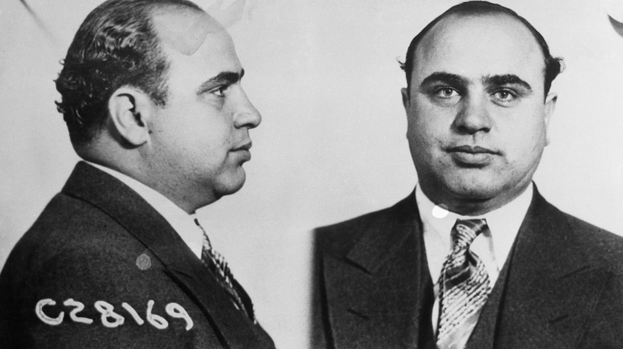
Why Would I Want to Pay Taxes?
Notes:
That is Alphonse Gabriel Capone, Al Capone, the real “Scarface”, “Public Enemy No. 1”; born here in Brooklyn actually. Specifically, that’s his mugshot from 1931 when the feds finally took him down for good; not for murder, not for prostitution, not for bootlegging, not for racketeering; for tax evasion. This is a guy who was responsible for dozens of murders and the FBI couldn’t get anything to stick; the IRS put him down for 11 years on fucking back taxes. Moral of the story here, don’t fuck with the IRS.

Slide 19
The Basics
Burner wallets / addresses
Notes:
By necessity, your, uh, customers are going to be sending bitcoin to an address. That means they’re either going to know that address or there’s going to be some sort of transaction from them that ends at that address. In both cases, that address, and the wallet that is associated with it, have to be considered compromised. Think of those bitcoins as marked bills. Thanks to bitcoin’s public ledger, this explodes out to any other addresses those coins touch.

Slide 20
The Basics
Burner wallets / addresses
Bitcoin tumblers
Alt-coin exchanges
Notes:
This is where bitcoin tumbler services and alt-coin exchanges come in. The concept behind tumblers is you put your bitcoins in, they get mixed into a giant pool of bitcoins other people have put in, and then you take out some other bitcoins. Ostensibly they’re for privacy; practically it’s bitcoin laundering. You can accomplish the same effect by exchanging you bitcoin for one of the umpteen alt-coins and then exchanging those alt-coins for bitcoin; bonus points for using different exchanges. Now, something to keep in mind with both of these are correlation attacks. If Address A puts 3 btc into a tumbler and the tumbler immediately sends 3 btc to Address B, the obvious conclusion is that those two addresses are associated. Instead you want Address A to put 3 btc into the tumbler then, some random time later, the tumbler sends 0.5 btc to Address B, a random delay after that it sends 0.25 btc to addresses C and D; and so on until it’s all out of the tumbler.

Slide 21
The Basics
Burner wallets / addresses
Bitcoin tumblers
Alt-coin exchanges
Anonymous companies
Registered Agents
Holding companies
Offshore shell companies
Notes:
These are all related. Essentially they’re all going to play into each other to make a giant tangled web of ownership structures that help us meet a few of our goals.

Slide 22
The Basics
Burner wallets / addresses
Bitcoin tumblers
Alt-coin exchanges
Anonymous companies
Registered Agents
Holding companies
Offshore shell companies
Foreign bank accounts
Currency exchanges
Notes:
Remember that exchange bitcoin for alt-coins, exchange alt-coins for bitcoins trick? When you have offshore shell companies, you can get foreign bank accounts under them. When you have foreign bank accounts you can pull that same trick with meatspace money.

Slide 23
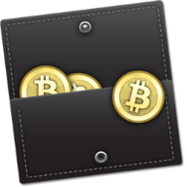

What This Looks Like
Victim
Wallet
Payment
Wallet
Consolidation
Wallet
Dirty
Wallets
Bitcoin
Tumblers
Clean-ish
Wallets

Slide 24
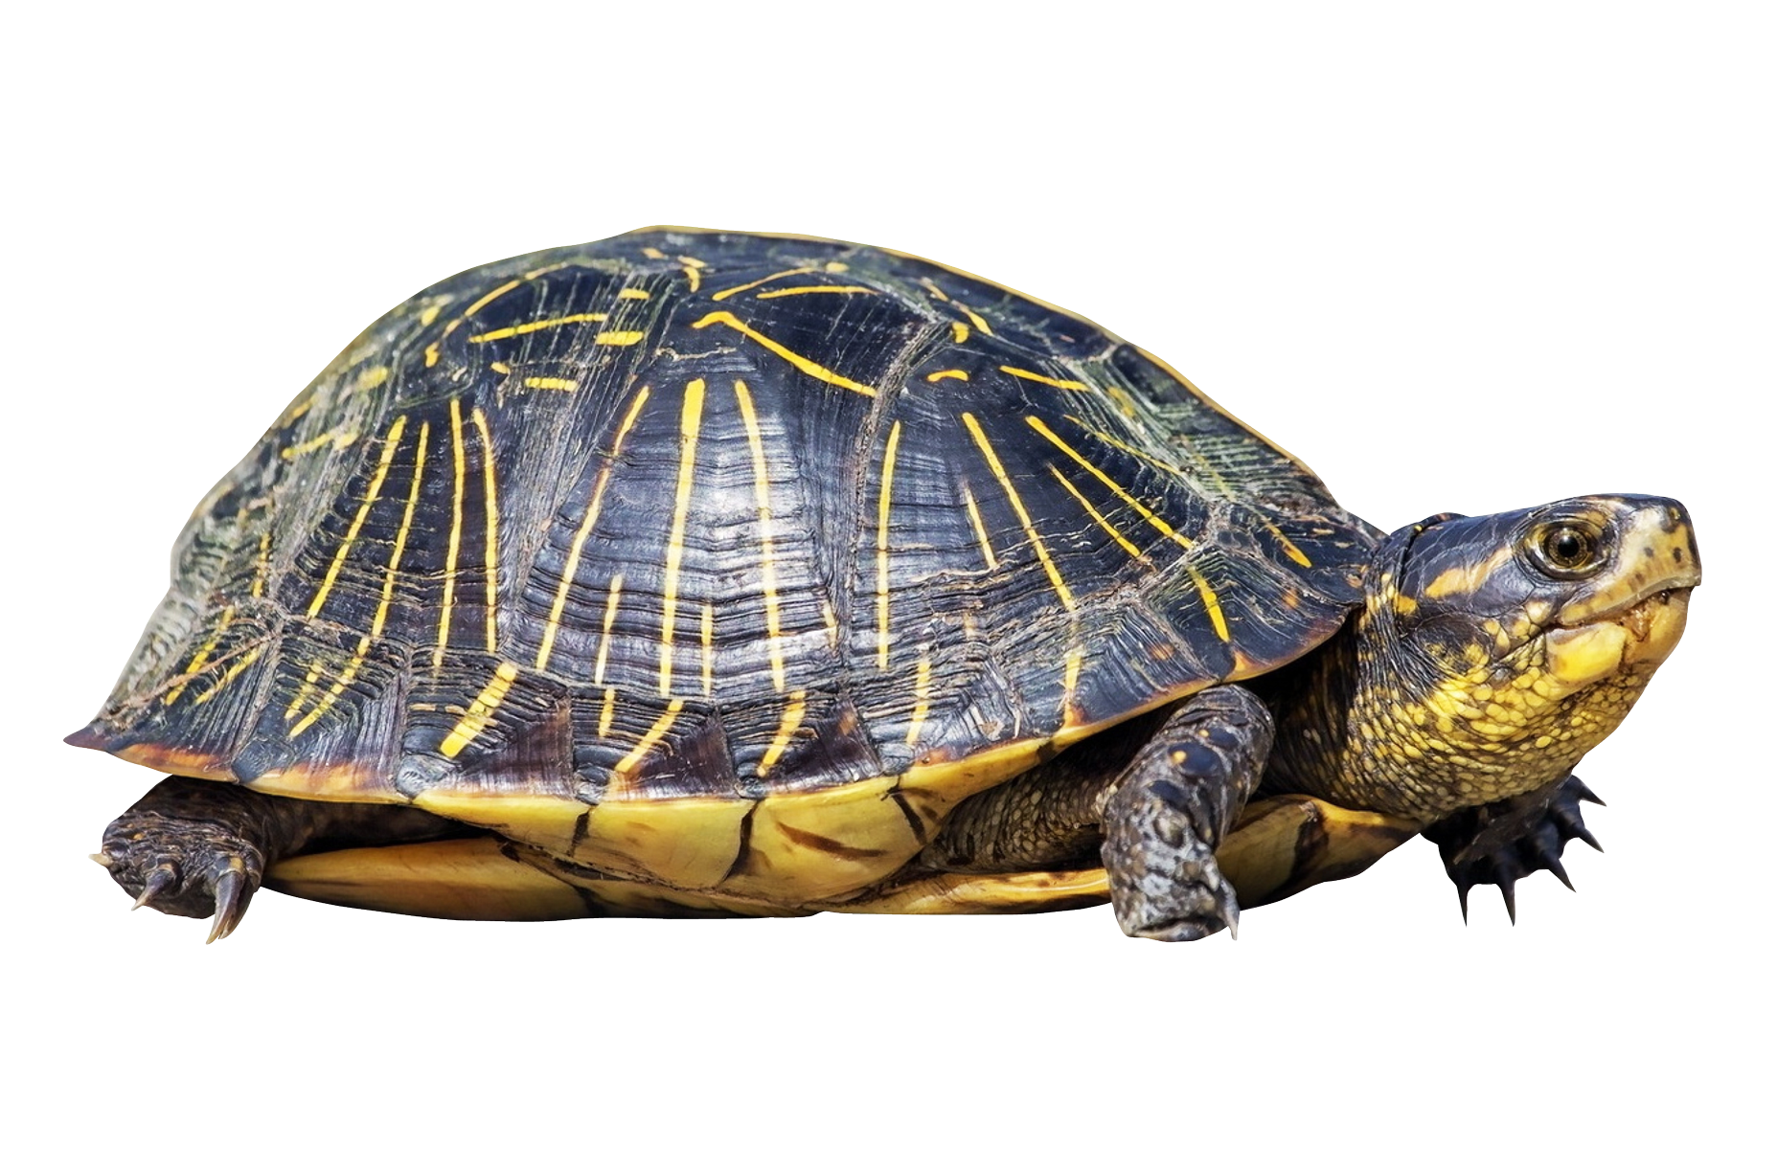
Shells And Shells And Shells And…
Notes:
Quick aside before getting into the whole tangled web of headfuckery; many places, including several US states, will allow you to register a company to another company that doesn’t exist yet, that company can then be registered to the first company resulting in Company A being owned by Company B while Company B is owned by Company A.

Slide 25
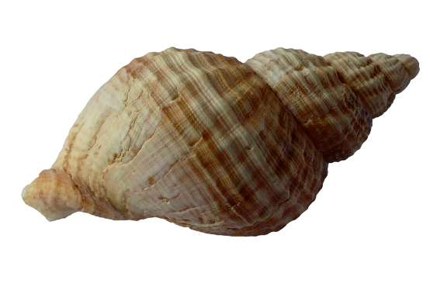
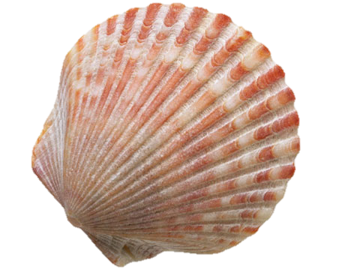
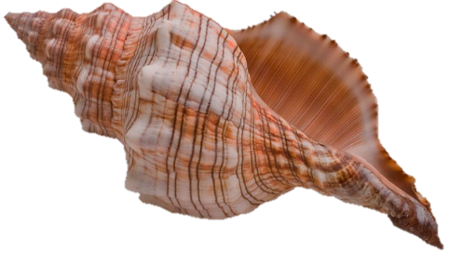
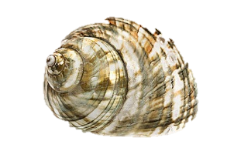
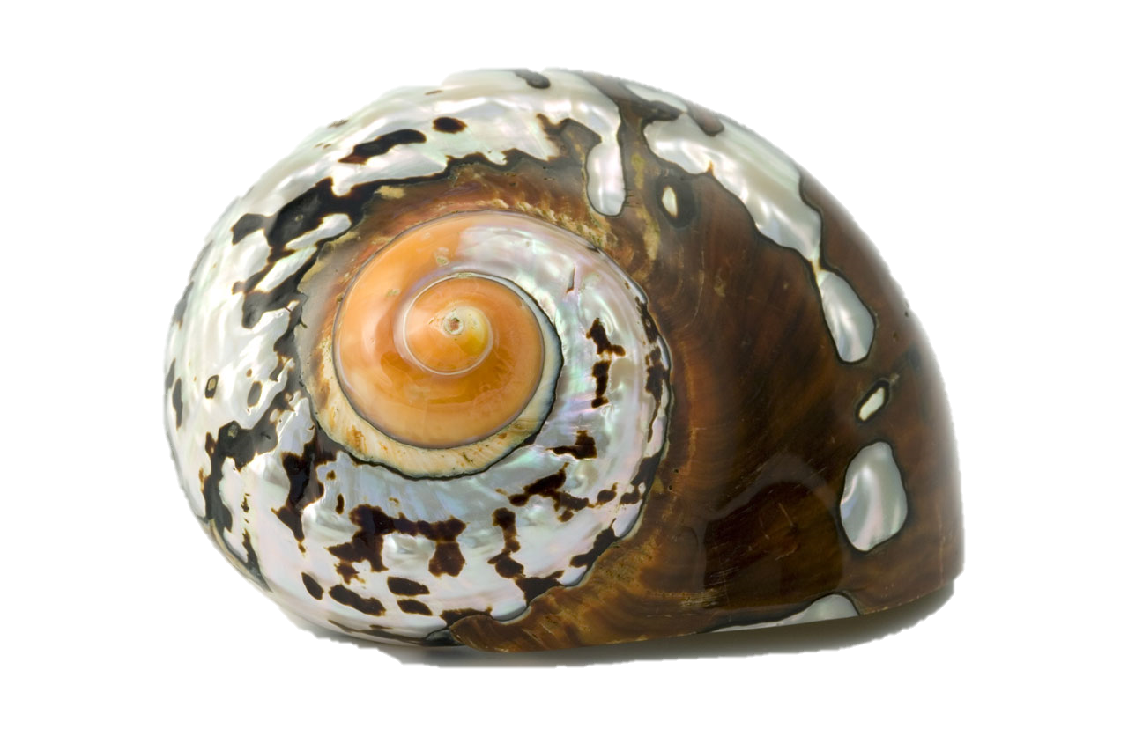
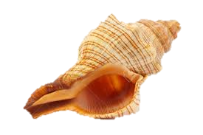
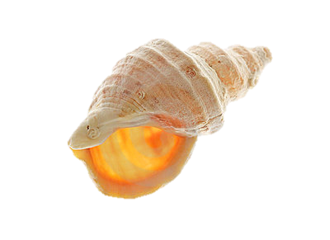
Shells And Shells And Shells And…

Slide 26
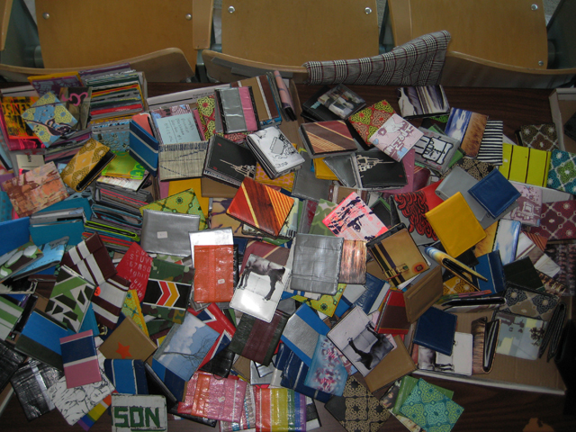
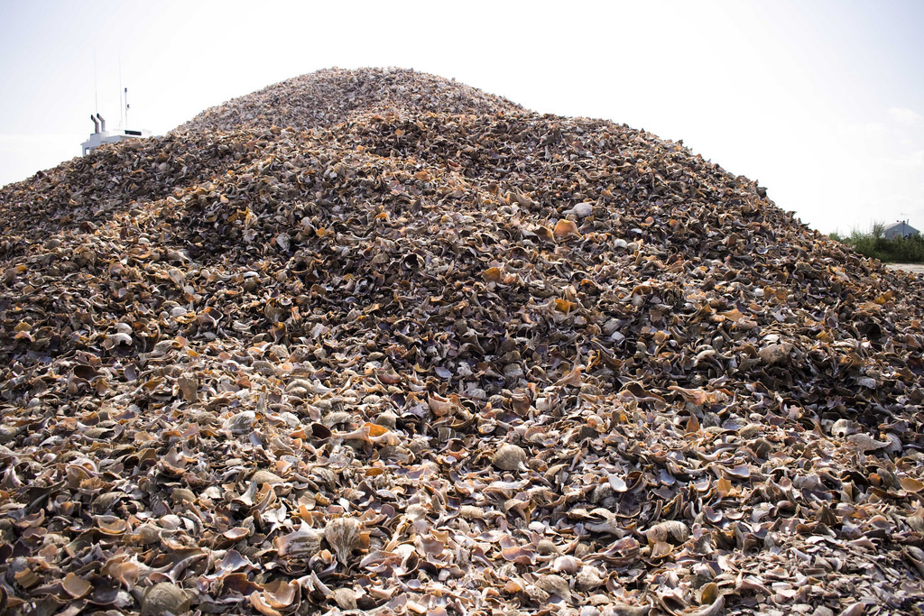
And You End Up With…

Slide 27
Putting It All Together

Slide 28
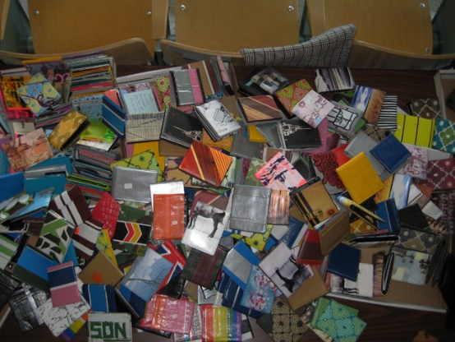
Putting It All Together
Pile-O-Wallets
(Dirty)
Pile-O-Wallets
(Clean)
Lots-O-Tumblers

Slide 29
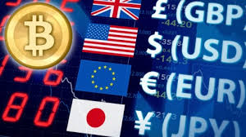

Putting It All Together
Pile-O-Wallets
(Clean)
Multiple Exchanges
In
Multiple Countries
Accounts held by your
Pile-O-Shells

Slide 30
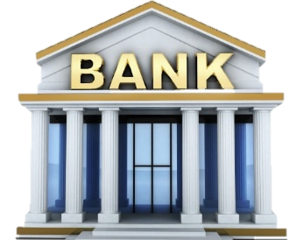
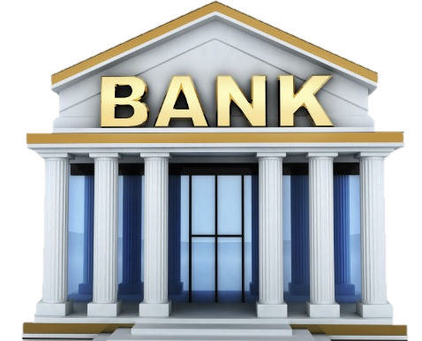
Putting It All Together

Slide 31
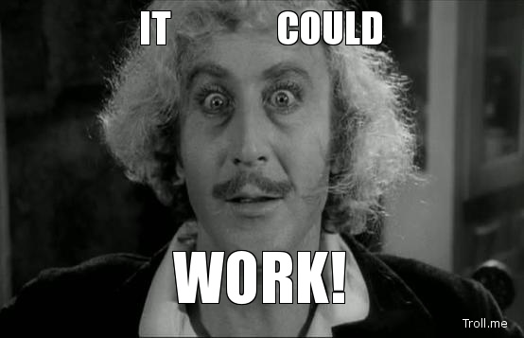

Slide 32


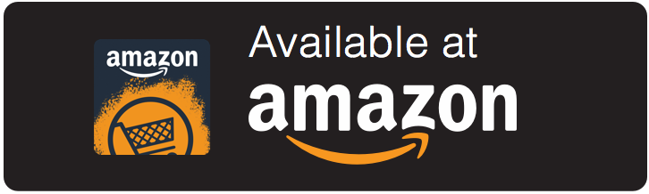
Another Layer Of Fuckery

Slide 33
Who I Stole This From
Claud Xiao
“The Underground Economy of Apple ID”
Bsides San Francisco – 2017
https://github.com/secmobi/slides/
Section on app fraud
Buying app ranking
Rigging recommendations
Buying premium apps and IAP

Slide 34
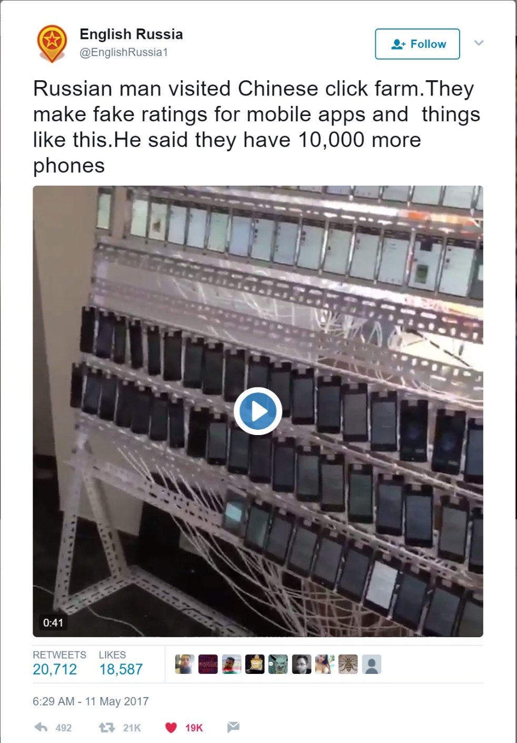
https://twitter.com/EnglishRussia1/status/862661011882561537

Slide 35
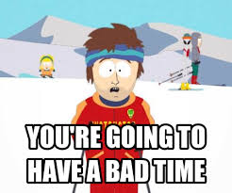
Things To Keep In Mind
Stay low profile
If you go to the front page
If you use one dev account for tons of apps
If your shovel-ware is too blatant
Expensive apps raise suspicions
Especially when they sell well
Accounts will probably get banned at some point
Notes:
Set up dev accounts under shell companies

Slide 36


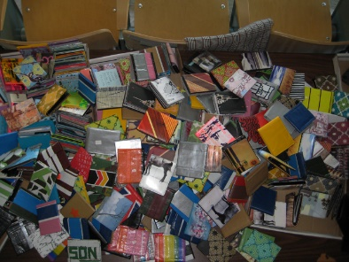
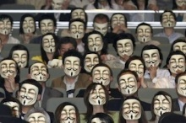



Slide 37
Special Thanks To
A number of people who wish to remain anonymous
Vyrus
Claud Xiao
All the HushCon Crew

Slide 38
Questions?

